Slide 1
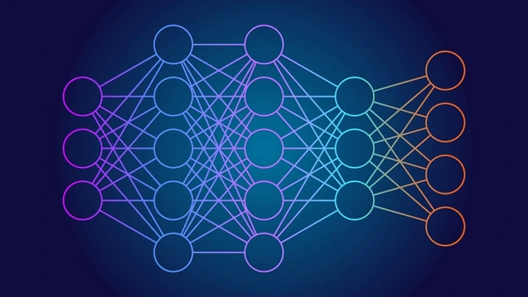
Convolutional Neural Networks (CNNs)
Discussion and Application
STUDENT NAME: BOBOYE DAMILARE ADEJUWON
STUDENT ID: 202346817

Slide 2
Introduction to Convolutional Neural Networks
What is a Convolutional Neural Network (CNNs) ?
A unique type of deep learning architecture commonly used for image classification tasks.
It works by convolving around the input image to extract relevant features which passes through different neural layers to generate an output (Russell and Norvig, 2021).
Key Features of a Convolutional Neural Network
Convolutional Layers: These layers apply filters called kernels to detect spatial hierarchy of features (layered abstraction). Each convolution layer has a ReLu activation function that penalizes negative values to zero in the convolution operation.
Pooling layers: These layers reduce spatial dimensions from convoluted output called feature maps. Improves computational efficiency.
Fully Connected Layers: The classification part of CNNs. Each neuron is connected to each neuron from its previous layer. The last layer is used as the output (classifier)
Strengths of CNNs as a Machine Learning technique
Powerful for feature learning/extraction
Learn visual patterns from input data
Maintain spatial invariance regardless of image position i.e. rotation, flipping, zooming.
Shared weights and local connectivity reduces the number of parameters in neural network
Scalability allows them effectively handle large-scale datasets suitable for computer vision tasks.

Slide 3
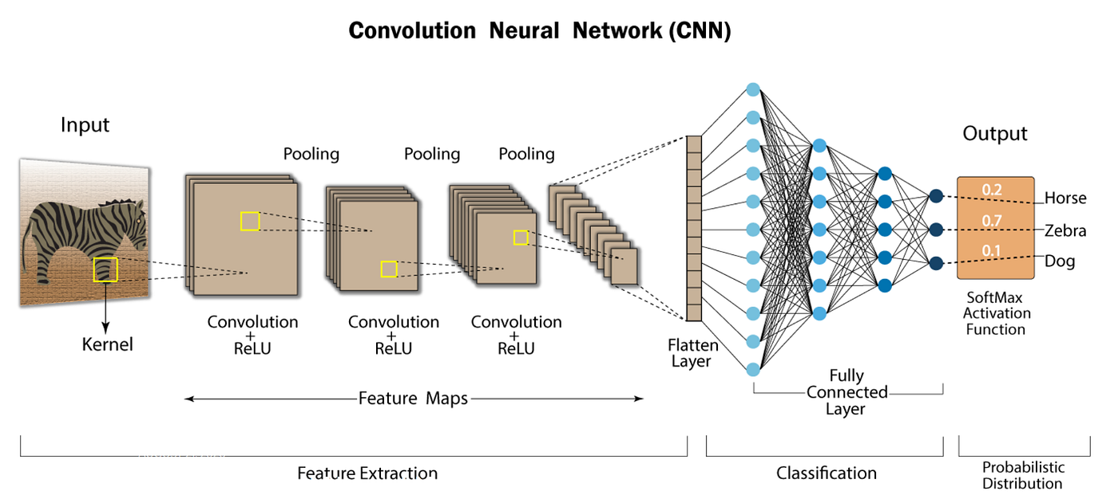
Introduction to Convolutional Neural Network: Architecture
Architecture of a CNN

Slide 4

Feature Extraction
Layered Abstraction involves extracting relevant features at different levels. From low-level feature to high-level features.
High-level abstraction (full representation i.e. facial structure)
Layered abstraction follows a hierarchical structure. From low-level features, to mid-level features and then high-level features. Highest abstraction is a complete representation of the image.
Mid-Level Abstraction (eyes, nose, mouth, ears)
Low-level abstraction (edges, circles, colors)

Slide 5
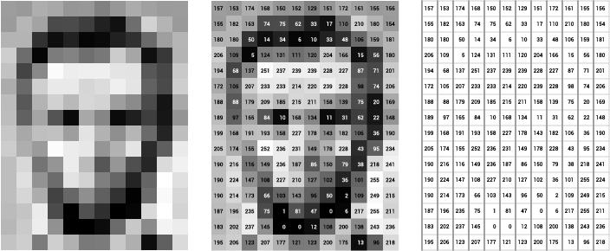
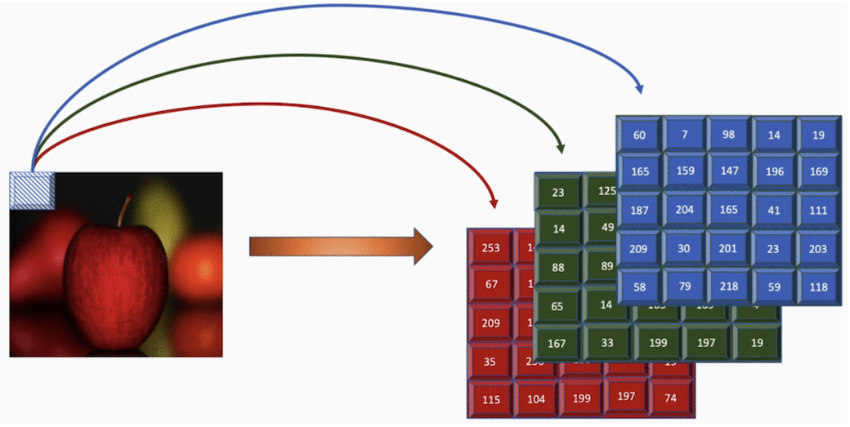
Input Image data represented as pixel values [0,255].
Classification
ArgMax Probabilities
Convolution operation
Lincoln = 0.5
Jefferson = 0.3
Obama = 0.2
Input Image data can be colored (2D) or greyscale (1D). In terms of colored images, images are represented as Red, Green, Blue (RGB) with each corresponding matrix of pixel values.
Apple = 0.5
Orange = 0.3
Grapes = 0.2
Convolution operation
Classification
ArgMax Probabilities

Slide 6
Convolution Operation
2 | 1 | 0 | 2 | 2
0 | 2 | 2 | 1 | 1
1 | 1 | 2 | 1 | 0
2 | 2 | 1 | 1 | 2
0 | 1 | 0 | 2 | 1
2 | 1 | 0
0 | 2 | 2
2 | 2 | 1 | 2
0 | 1 | 2 | 1
1 | 1 | 2 | 0
2 | 1 | 2 | 1
3x3 kernel
Bias
Feature Map
Image data
This is the most important component in a CNN architecture.
In a convolution operation, a kernel also known as a filter convolves around the input image using specified parameters i.e. kernel size of 3x3, 5x5. The kernel also uses stride length to convolve across the input matrix. Stride length refers to the steps that the kernel takes as it moves over the image.
Weights are randomly assigned to the kernel values, and a bias. The result is a feature map which goes into the pooling layer.

Slide 7
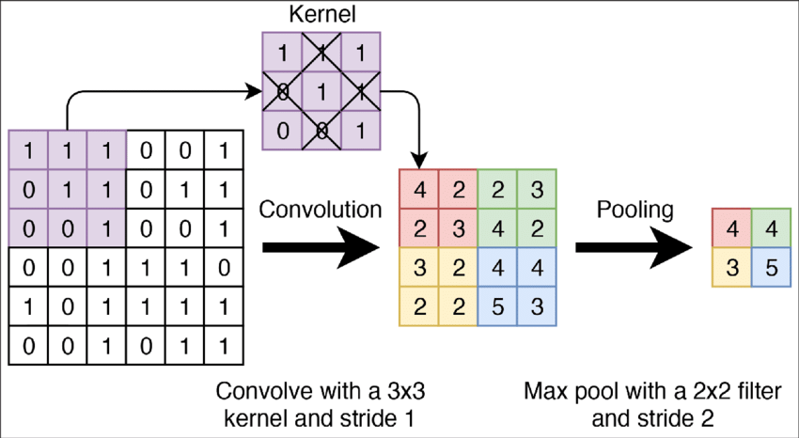
Understanding Convolutional Neural Networks
Pooling Operation furthers dimensionality reduction such that feature maps are subsampled while preserving spatial Invariance. It reduces the overall count of parameters.
Pooling reduces spatial dimensions of input feature maps while retaining the most import information (features).
It involves sliding at least a two-dimensional filter over each channel of a feature map using a kernel filtering method.
Pooling techniques can be maximum, average or minimum.

Slide 8
Fully connected Layer: Classification
Lion
Input from Pooling Layer
Cheetah
Zebra
Flatten Layer
Fully Connected Layer
Softmax
The above operation occurs in a fully connected layer known as the classification layer. The input from the pooling layer is first flattened into a 1D array and passed to the dense layer which performs classification tasks. Finally, the last layer, called the output layer typically uses a softmax activation function and assigns probabilities to predicted classes.

Slide 9
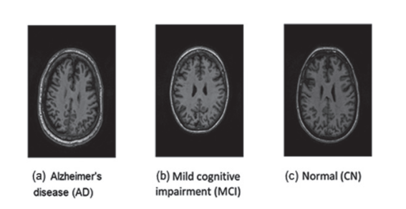
Application of Convolutional Neural Networks: Comparing Two Case Studies
In this section, the application of a convolutional neural network is explained in research employing Dakdareh and Abbassian (2024) study, titled, ‘Diagnosis of Alzheimer’s Disease and Mild Cognitive Impairment Using Convolutional Neural Networks’.
The main aim of the paper is to diagnose Alzheimer’s disease and Mild Cognitive Impairment in healthy individuals using convolutional neural networks.
The methodology adopted included two pretrained models, AlexNet and DenseNet-BC and a custom CNN1D-LSTM model. The dataset was obtained from Alzheimer’s Disease Neuroimaging Initiative, however a 2D version obtained from Kaggle was used in the study.
AlexNet pretrained model achieved an accuracy of over 98% in diagnosing Alzheimer’s disease, Mild Cognitive Impairment in healthy individuals. Outperformed DenseNet-BC and CNN1D-LSTM model respectively.
https://go.exlibris.link/1cqd1WYy

Slide 10
References
Dakdareh, S.G. & Abbasian, K. 2024, "Diagnosis of Alzheimer’s Disease and Mild Cognitive Impairment Using Convolutional Neural Networks", JAD reports, vol. 8, no. 1, pp. 317-328

